Slide 1



Dr. Hiba Shakir Ahmed
Microbiology / Clinical Immunology

Slide 2
Replication of viruses
Lecture 3

Slide 3
Viruses multiply only in living cells. The host cell provides the energy and synthetic machinery and the low-molecular- weight precursors for the synthesis of viral proteins and nucleic acids. The viral nucleic acid carries the genetic specificity to code for all of the virus-specific macromolecules in a highly organized fashion .
For a virus to replicate, viral proteins must be synthesized by the host cell protein-synthesizing machinery. Therefore, the virus genome must be able to produce a functional mRNA. Various mechanisms have been identified that allow viral RNAs to compete successfully with cellular mRNAs to produce adequate amounts of viral proteins.

Slide 4
The unique feature of viral multiplication is that soon after interaction with a host cell the infecting virion is disrupted and its measurable infectivity is lost. This phase of the growth cycle is called the eclipse period; its duration varies depending on both the particular virus and the host cell, and it is followed by an interval of rapid accumulation of infectious progeny virus particles.

Slide 5
General Steps in Viral Replication Cycles :
A variety of different viral strategies have evolved for accomplishing
multiplication in parasitized host cells. Although the details vary from group to group, the general outline of the replication cycles is similar.
A. Attachment, Penetration, and Uncoating
The first step in viral infection is attachment, interaction of a virion with a specific receptor site on the surface of a cell.
Receptor molecules differ for different viruses but are generally glycoproteins. In some cases, the virus binds protein sequences (eg, picornaviruses) and in others oligosaccharides (eg, orthomyxoviruses and paramyxoviruses).

Slide 6
In some systems, this is accomplished by receptor-mediated endocytosis, with uptake of the ingested virus particles within endosomes. There are also examples of direct penetration of virus particles across the plasma membrane. In other cases, there is fusion of the virion envelope with the plasma membrane of the cell. Those systems involve the interaction of a viral fusion protein with a second cellular receptor or coreceptor.

Slide 7
Uncoating
Occurs concomitantly with or shortly after penetration. Uncoating is the physical separation of the viral nucleic acid from the outer structural components of the virion so that it can function.
The genome may be released as free nucleic acid (picornaviruses) or as a nucleocapsid (reoviruses). The nucleocapsids usually contain polymerases. Uncoating may require acidic pH in the endosome. The infectivity of the parental virus is lost at the uncoating stage.
Viruses are the only infectious agents for which dissolution of the infecting agent is an obligatory step in the replicative pathway.

Slide 8
B. Expression of Viral Genomes and Synthesis of Viral Components :
The synthetic phase of the viral replicative cycle ensues after uncoating of the viral genome.
Early viral mRNA synthesis( transcription).
Various class
A-DNA viruses
The genome of the all DNA viruses consist of double strand (ds) DNA, except for the parvovirus , which have a single strand (ss) DNA genome. Replication in the nucleus and use the host cell DNA – dependent RNA polymerase to synthesize their mRNA, while the pox viruses replicate in the cytoplasm ,they carry their own polymerase within the virus particle.

Slide 9
B- RNA viruses
The production of mRNA and viral progeny in RNA viruses:
dsRNA
include one (+) and one (-) strand
(-) strand transcribed into mRNA by viral RNA polymerase
(+) strand is used directly as mRNA
mRNA is translated into protein
In single strand RNA (ssRNA),there are three different routes to formation of mRNA :
1-Single strand RNA of positive polarity (+ve sense RNA) these viruses use RNA genome directly as mRNA (e.g. poliovirus) (+) sense :ssRNA genome

Slide 10
(+) RNA enter to cell used directly as m RNA
protein are synthesized from mRNA
In addition (+) strand are transcribed to form(-) sense strand which in turn produce more (+) strands to produce more viral genes. Further cycles of transcription occur large no. of (+)strands packaging into virions.
2- Single strand RNA of negative polarity (-ve sense RNA ):
An mRNA must be transcribed by using the negative strand as a template
The virus carries its own RNA –dependent RNA polymerase e.g Influenza virus

Slide 11
(-) sense :ss RNA genome
(–)RNA enter the cell and can not used directly as mRNA
(-) strand is transcribed by viral RNA polymerase to (+) strand and than used directly as mRNA
proteins are synthesized from mRNA
In addition, new (-) strand are transcribed from the resulting (+)sense strand to produce more viral genome for packaging into capsids to form viral progeny.
Rabies : replication occur in cytoplasm
In others e.g Influenza : replication occurs in nucleus.

Slide 12
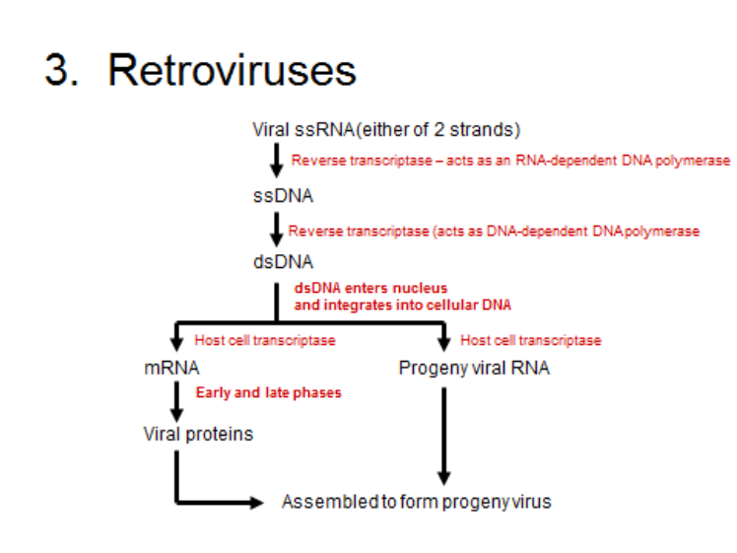
3- Single strand RNA of positive polarity (ss RNA + sense): The RNA transcribed to double- strand DNA by the RNA – dependent DNA polymerase reverse transcriptase carried by the virus .This DNA copies is then transcribed into viral mRNA by the regular host cell RNA polymerase ( e.g. retroviruses).

Slide 13


Early viral proteins synthesis (translation) occurring before genome replication
Once the viral mRNA of either DNA or RNA viruses is synthesized , it is translate by host cell ribosomes into viral proteins .Some of which are early proteins i.e enzymes required for replication of viral genome ,and others of which are late proteins , i.e structural proteins of the progeny viruses.
Early viral mRNA synthesis
Early viral proteins synthesis
Late viral mRNA synthesis
Late proteins synthesis

Slide 14
C- Assembly and release:
The progeny particles are assembled by packaging the viral nucleic acid within the capsid proteins. Virus particles are released from the cell by either of two processes:
1- Rupture of the cell membrane and release of mature particles (un-enveloped viruses ).
2- budding through the outer cell membrane (enveloped viruses).

Slide 15
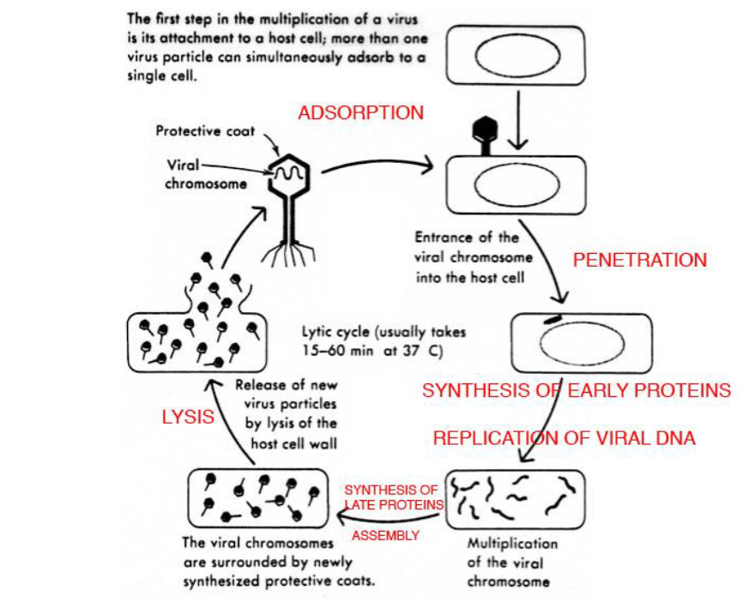

Slide 16
The effect of viral replication on host cell:
Death of the cell is probably due to inhibition of synthesis of protein and nucleic acid or due to lysis of cell membrane
Formation of inclusion bodies in nucleus or cytoplasm which contain viral particles such as Negri bodies found in rabies virus infected brain neurons .
Gaint cells are formed due to fusion of virus-infected cell, these occur as a result of cell membrane changes ,which are probably caused by the insertion of viral protein into the cell membrane such as herpes viruses.
Infection of the host cell with certain viruses causes malignant transformation ( increase or decrease division of the cell).
Some viruses may be cause morphological changes in surface of host cell (especially enveloped viruses).

Slide 17


